Slide 1
IBM-Coursera Course 9 - DATA SCIENCE CAPSTONE: BATTLE OF THE NEIGHBORHOODS
PROJECT TITLE:
WHERE TO LIVE IN CALGARY? (CANADA)
BY: Juan Sebastian Gomez Ramirez

Slide 2
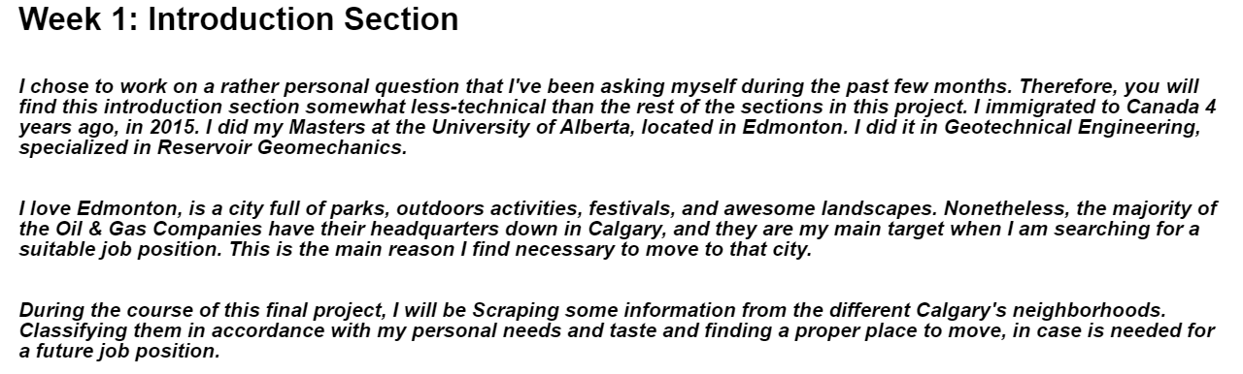
WEEK 1: INTRODUCTION & PROBLEM DESCRIPTION

Slide 3
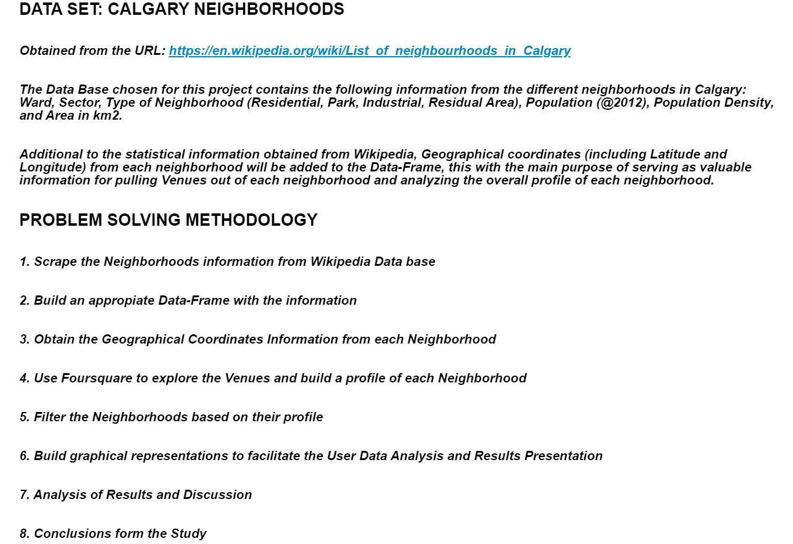
WEEK 1: INTRODUCTION & PROBLEM DESCRIPTION

Slide 4
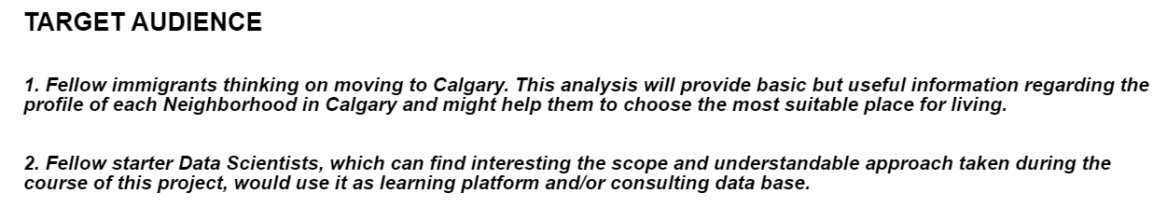
WEEK 1: INTRODUCTION & PROBLEM DESCRIPTION

Slide 5
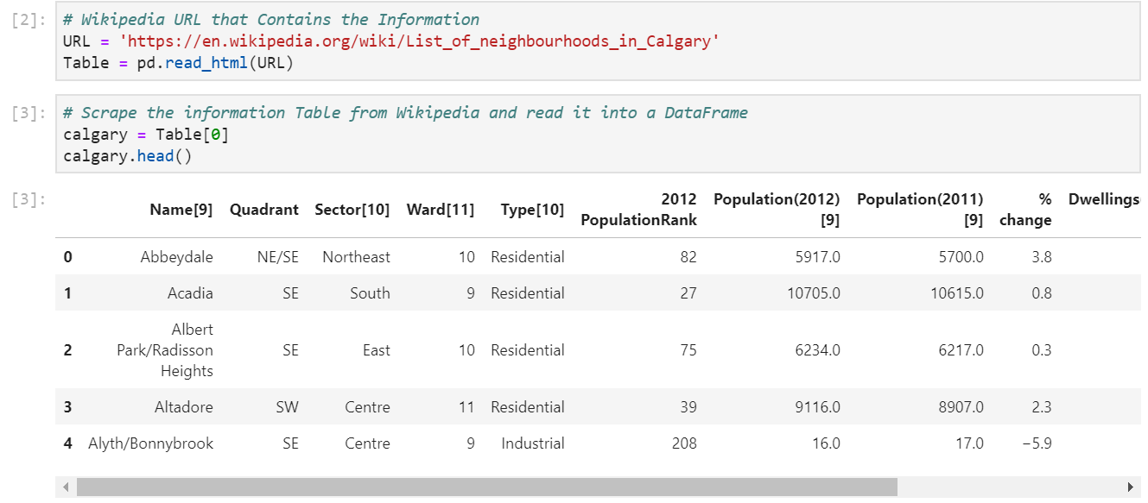
WEEK 2: CODING AND PROBLEM SOLVING METHODOLOGY
1. WIKIPEDIA DATA-SET WEB SCRAPING

Slide 6
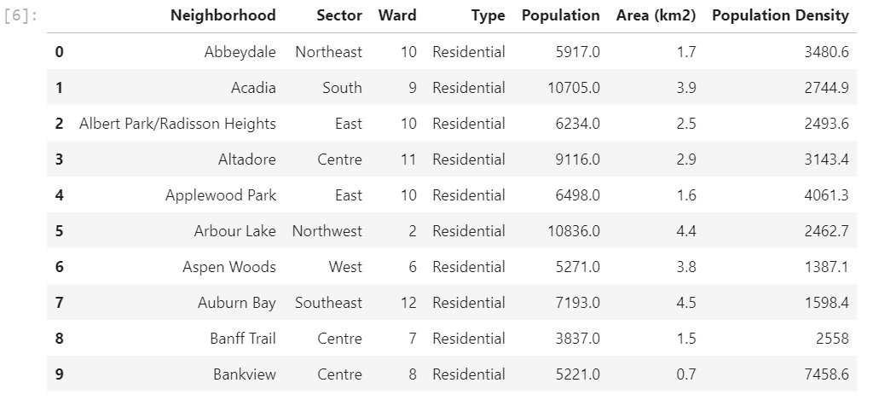
WEEK 2: CODING AND PROBLEM SOLVING METHODOLOGY
2. DATA-SET CLEAN UP
FUNCTIONS USED FOR THE CLEAN UP STAGE:
df.drop[]
df.rename()
df.reset_index()
df.shape

Slide 7
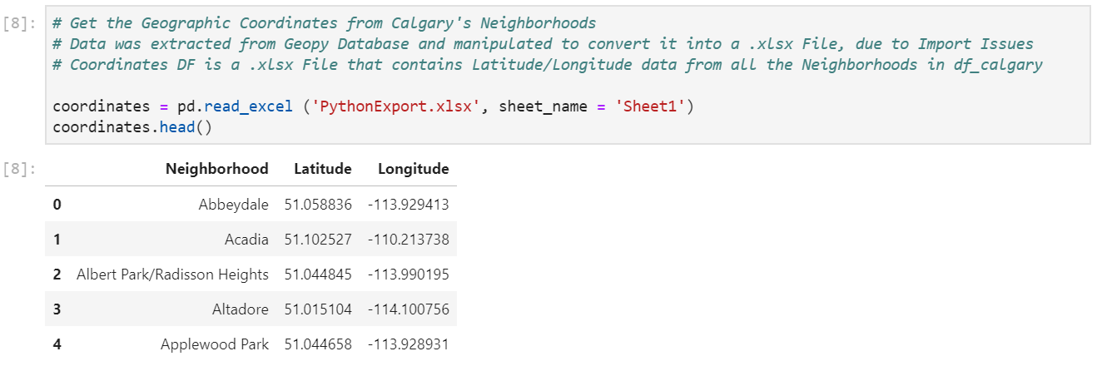
WEEK 2: CODING AND PROBLEM SOLVING METHODOLOGY
3. GEOGRAPHIC COORDINATES DATA-SET SCRAPING

Slide 8
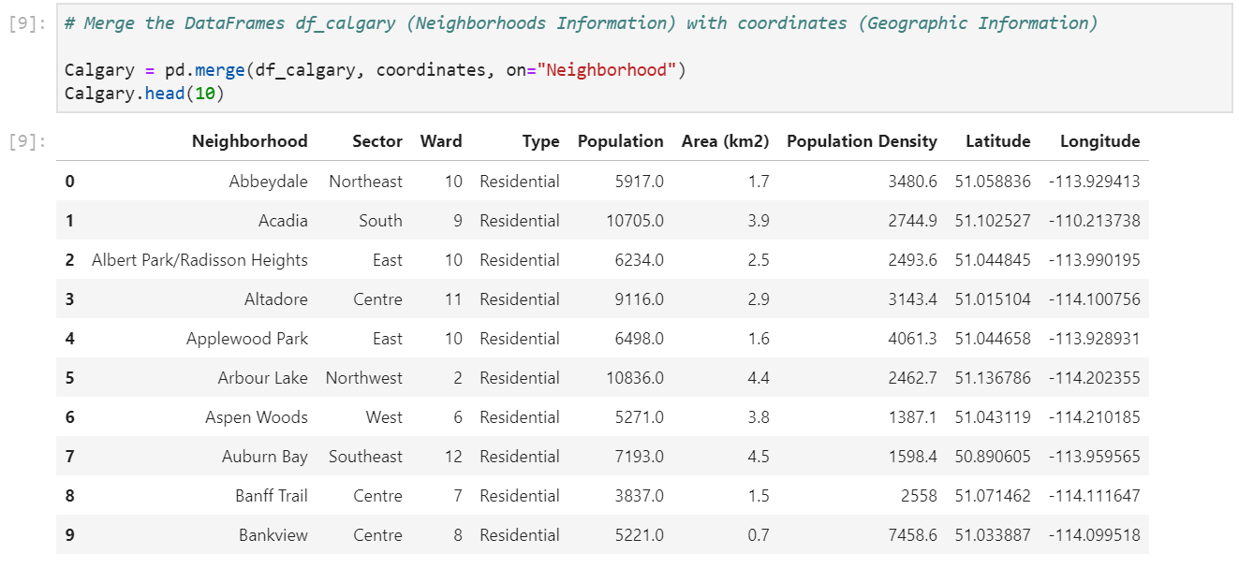
WEEK 2: CODING AND PROBLEM SOLVING METHODOLOGY
3. MERGE GEOGRAPHIC COORDINATES DATA-SET & DEMOGRAPHIC DATA-SET

Slide 9
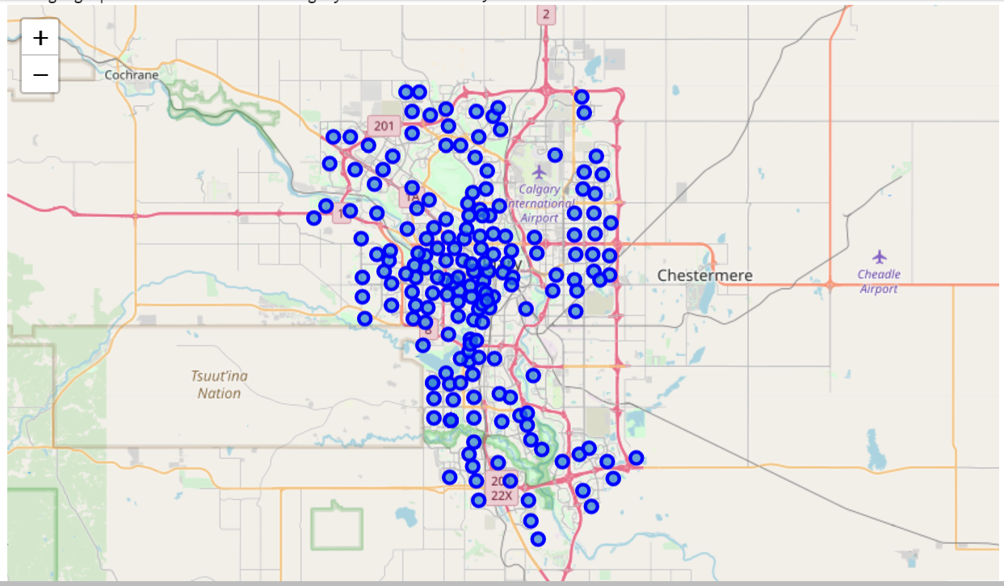
WEEK 2: CODING AND PROBLEM SOLVING METHODOLOGY
4. CALGARY NEIGHBORHOODS
NORTH SIDE

Slide 10
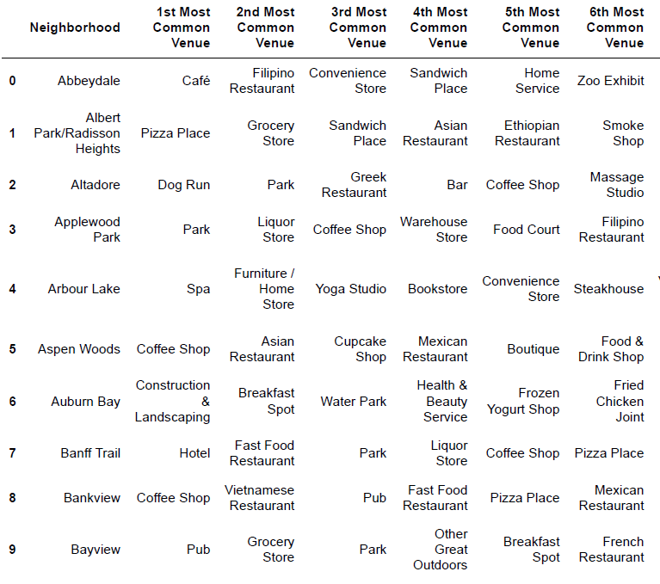
WEEK 2: CODING AND PROBLEM SOLVING METHODOLOGY
5. FOURSQUARE AND NEIGHBORHOODS’ VENUES PROFILING
FOURSQUARE API
+
CALGARY NEIGHBORHOODS GEOGRAPHIC COORDINATES
RADIUS OF INVESTIGATION: 1000 m FROM MAP MARK
LIMIT OF VENUES: 100

Slide 11
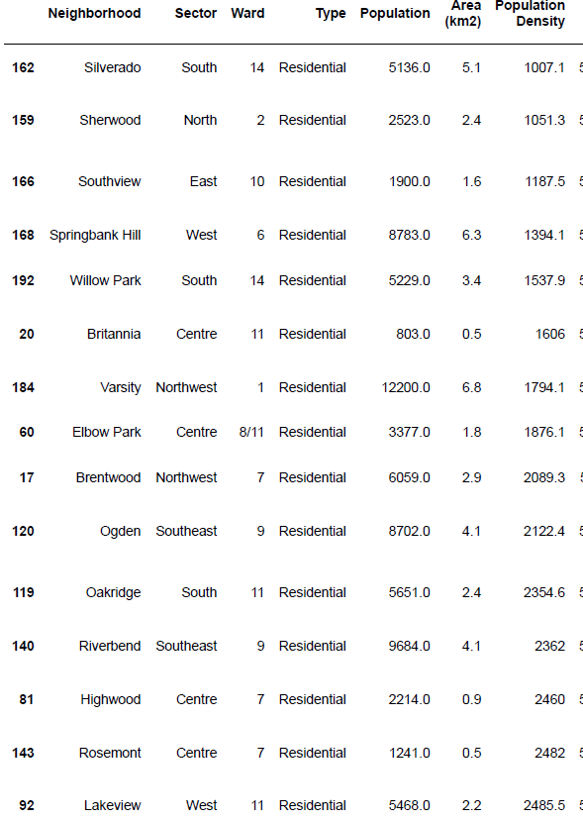
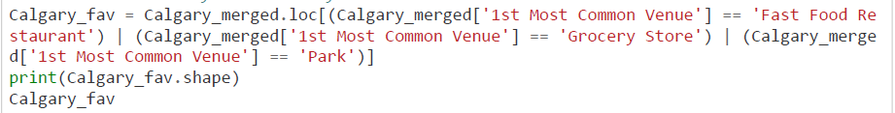
WEEK 2: CODING AND PROBLEM SOLVING METHODOLOGY
6. TOP NEIGHBORHOODS ACCORDING TO CONDITIONS: NEARBY GROCERY STORES, RESTAURANTS AND PARKS.
THE CODE USED ON THIS STAGE WAS DESIGNED TO TAKE INTO ACCOUNT THE THREE MAIN VENUES CONSIDERED IN THE STUDY. VARIATIONS CAN BE MADE ACCORDING WITH THE USER’S TASTE

Slide 12
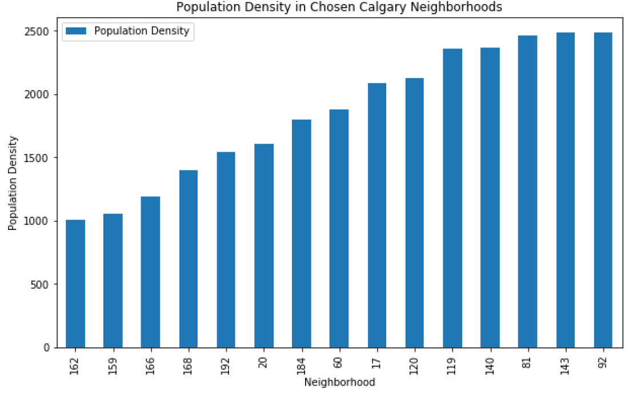
WEEK 2: CODING AND PROBLEM SOLVING METHODOLOGY
7. POPULATION DENSITY ANALYSIS
CENTRAL AND SOUTHERN BOUNDS POSSES THE HIGHER POPULATION DENSITY

Slide 13
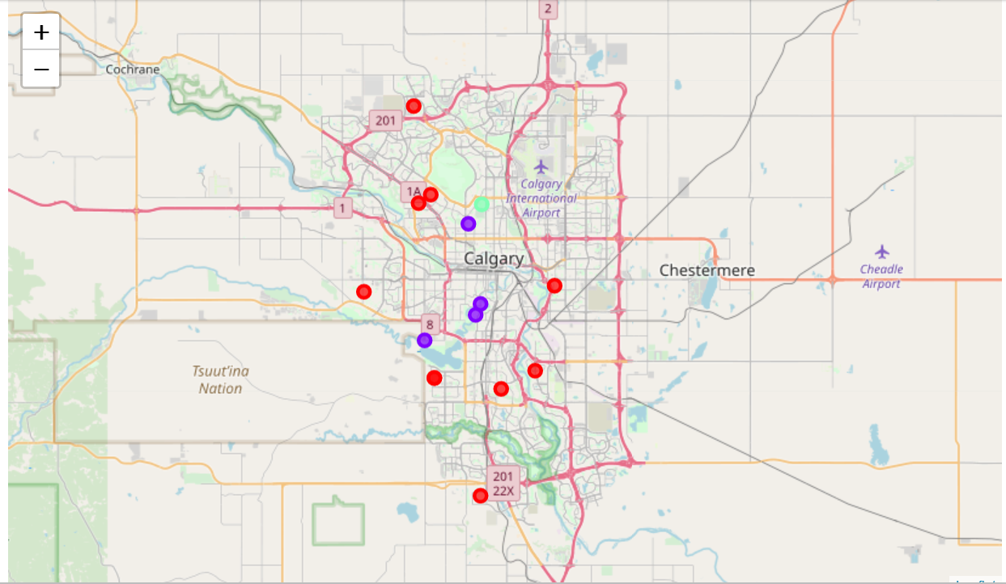
WEEK 2: CLUSTERED NEIGHBORHOODS

Slide 14
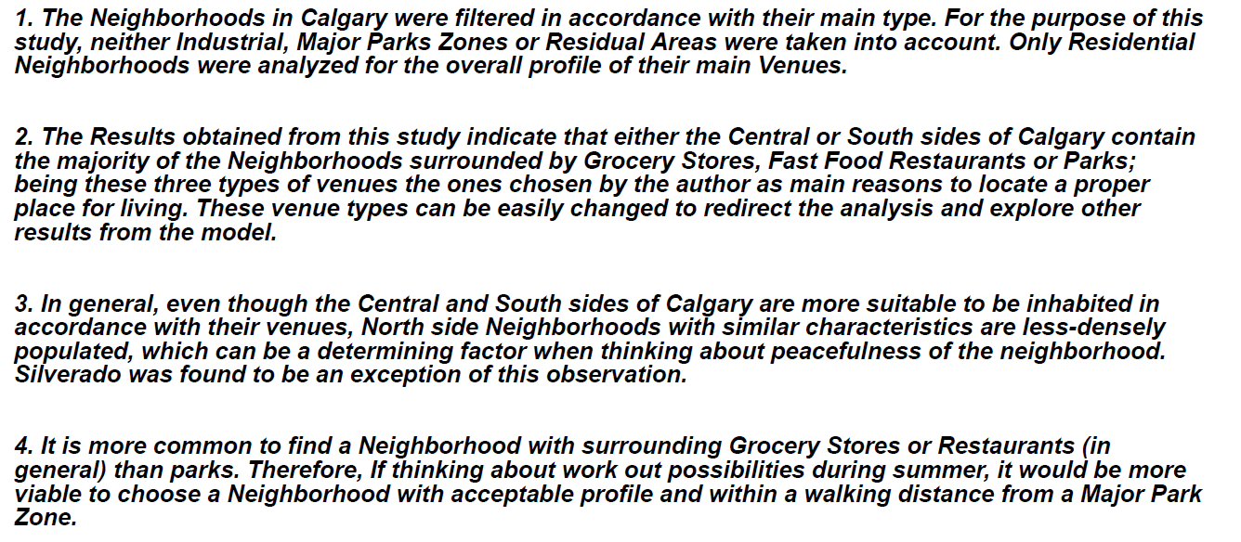
WEEK 2: RESULTS

Slide 15
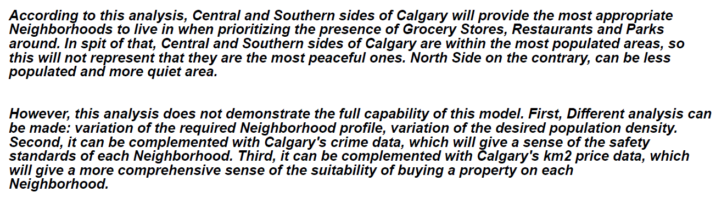
WEEK 2: DISCUSSION AND RECOMMENDATIONS

Slide 16
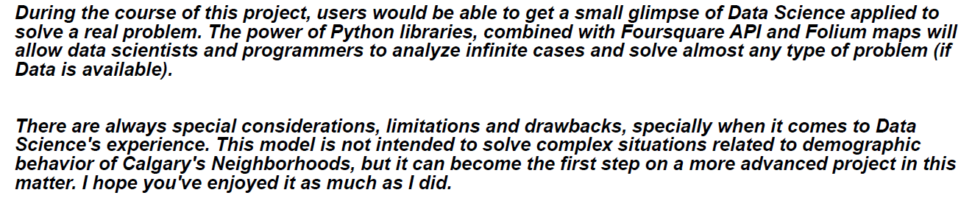
WEEK 2: CONCLUSIONS

